Slide 1
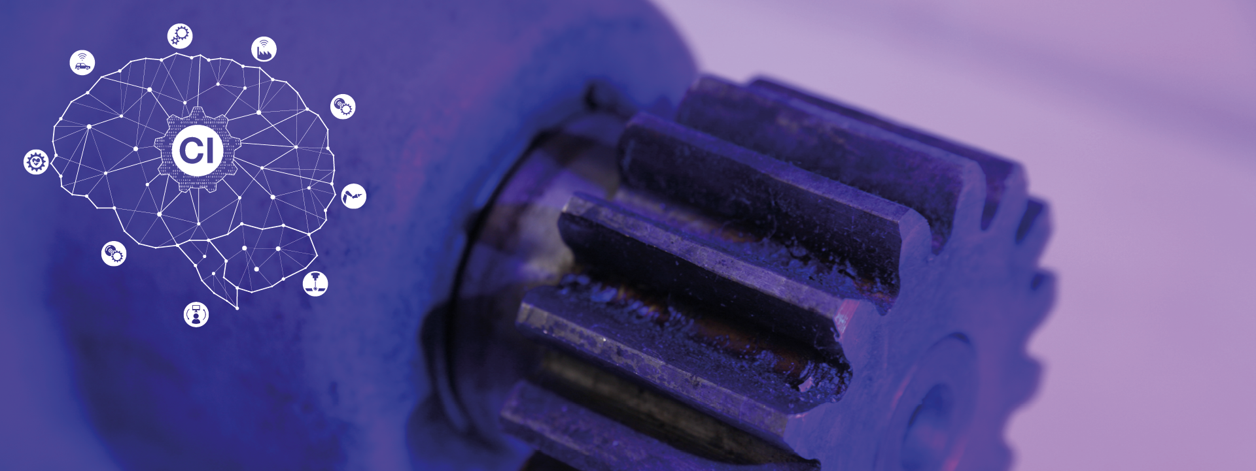
Project B
Group 5
Notes:
Hello, my name is Nayoung Ahn and I will be presenting on project B on behalf of my group no. 5.

Slide 2
Team Introduction
Responsibilities
Alejandro Delgadillo, Data augmentation
Jinyang Yu, Data preprocessing
Nayoung Ahn, Data preprocessing
Shuteng Wang, Neural network model
Xiaoyang Liu, Neural network model
Notes:
I’d like to introduce the team members and what they did.
Jinyang led the data processing team with Alejandro and myself
Xiaoyang led the neural network task with Shuteng

Slide 3
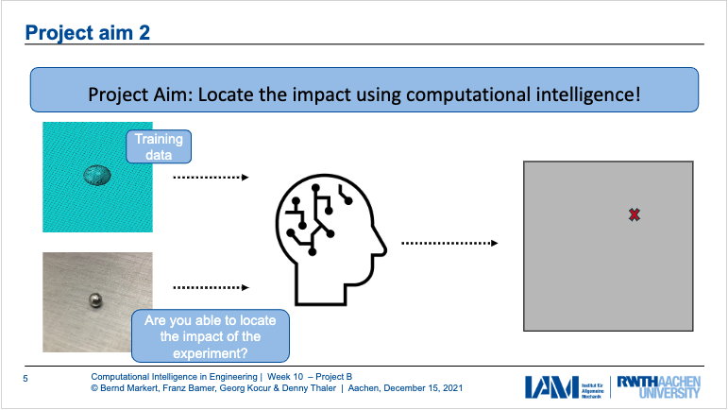
Motivation and Aim
Data
Numerical Data
EPOT data “EPOT_X_Y.mat”
Validation_augmented_data
Experimental Data
Experimental_data “impact_xy_###.txt” (group5)
Experimental_validation “impact_xy_X_Y_run_###.txt”
Notes:
For this project, our goal was to best predict the impact location via Neural Networks
(feeding and training it with numerical simulation data gathered from four piezoelectric transducers (sensors) on a small Aluminum plate.)
We first preprocess the provided data such that we have a good alignment of numerical and experimental data.

Slide 4
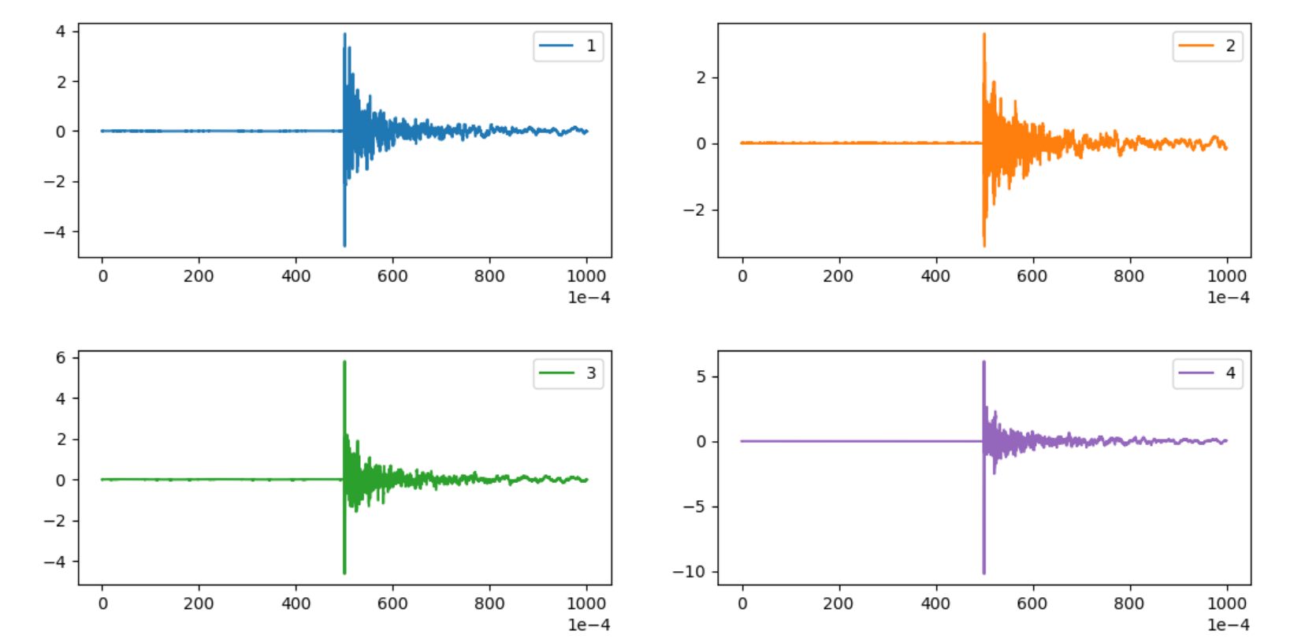
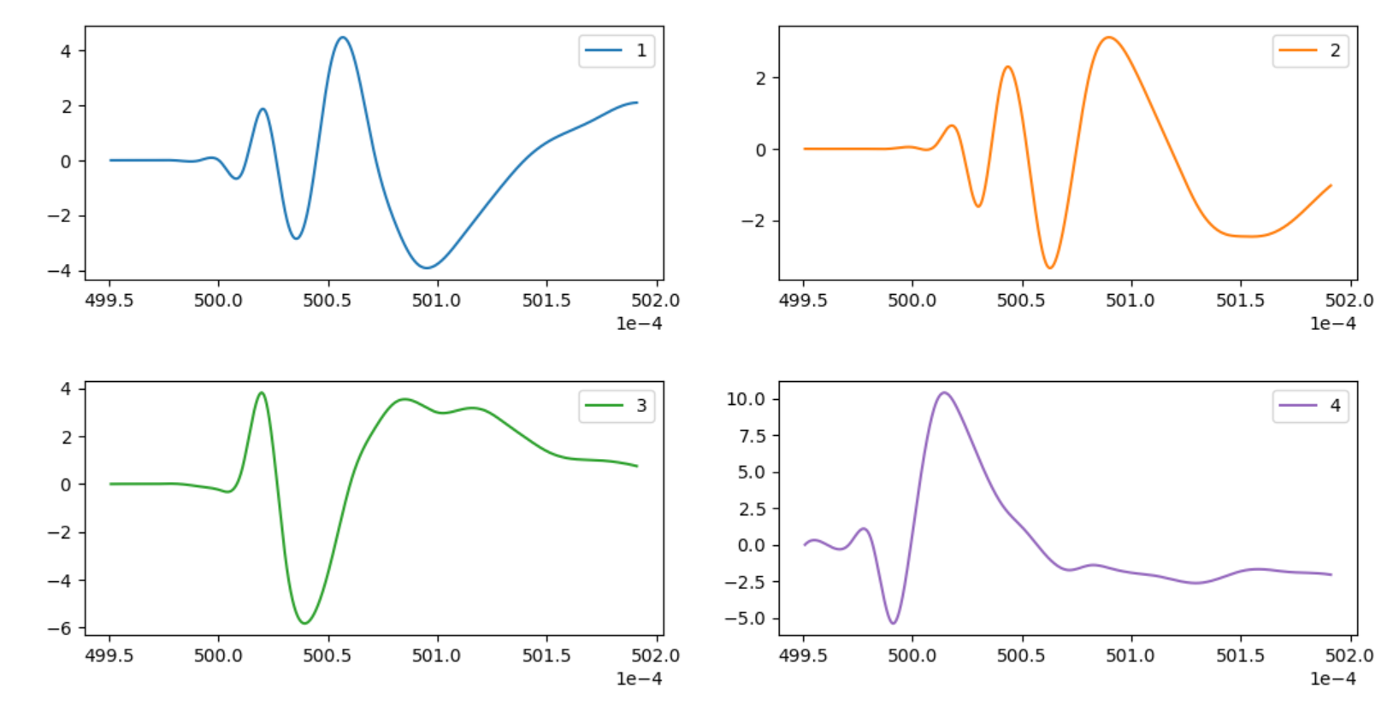
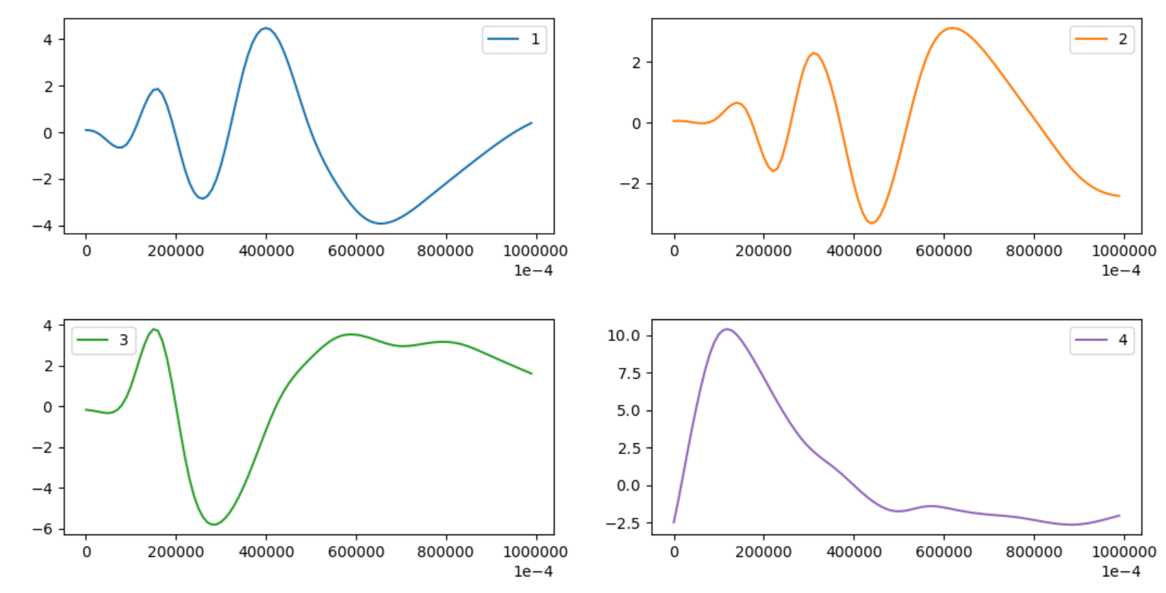
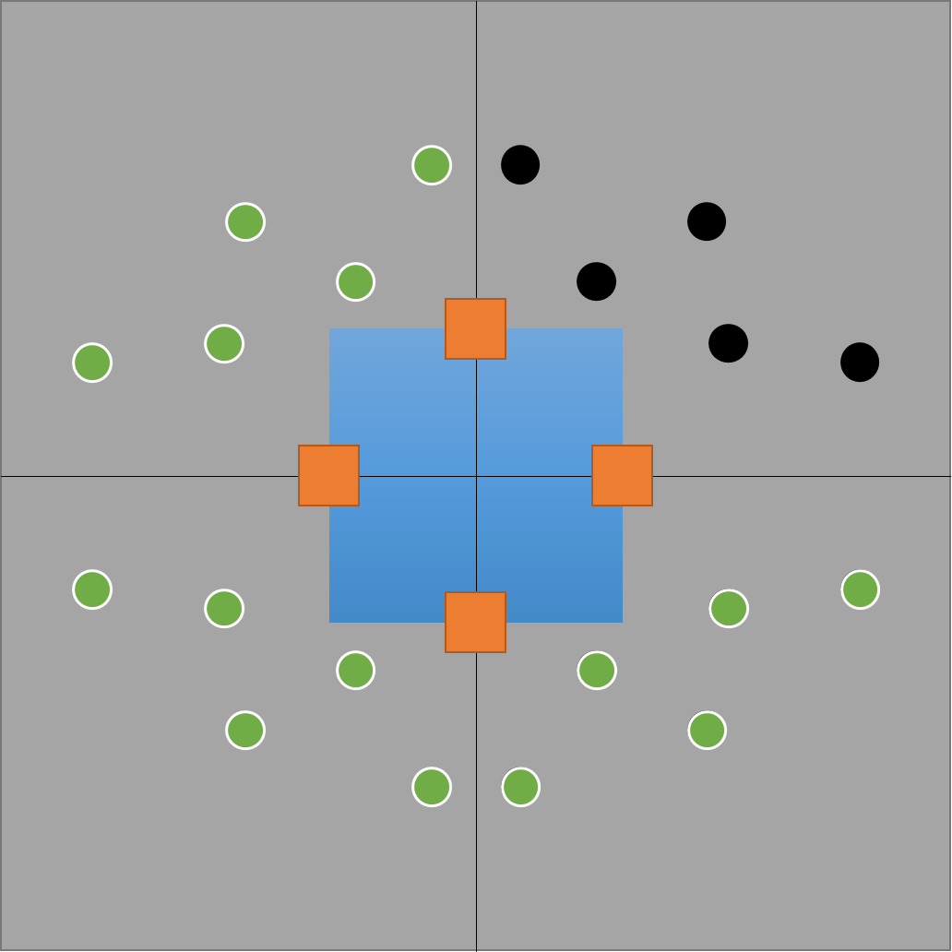
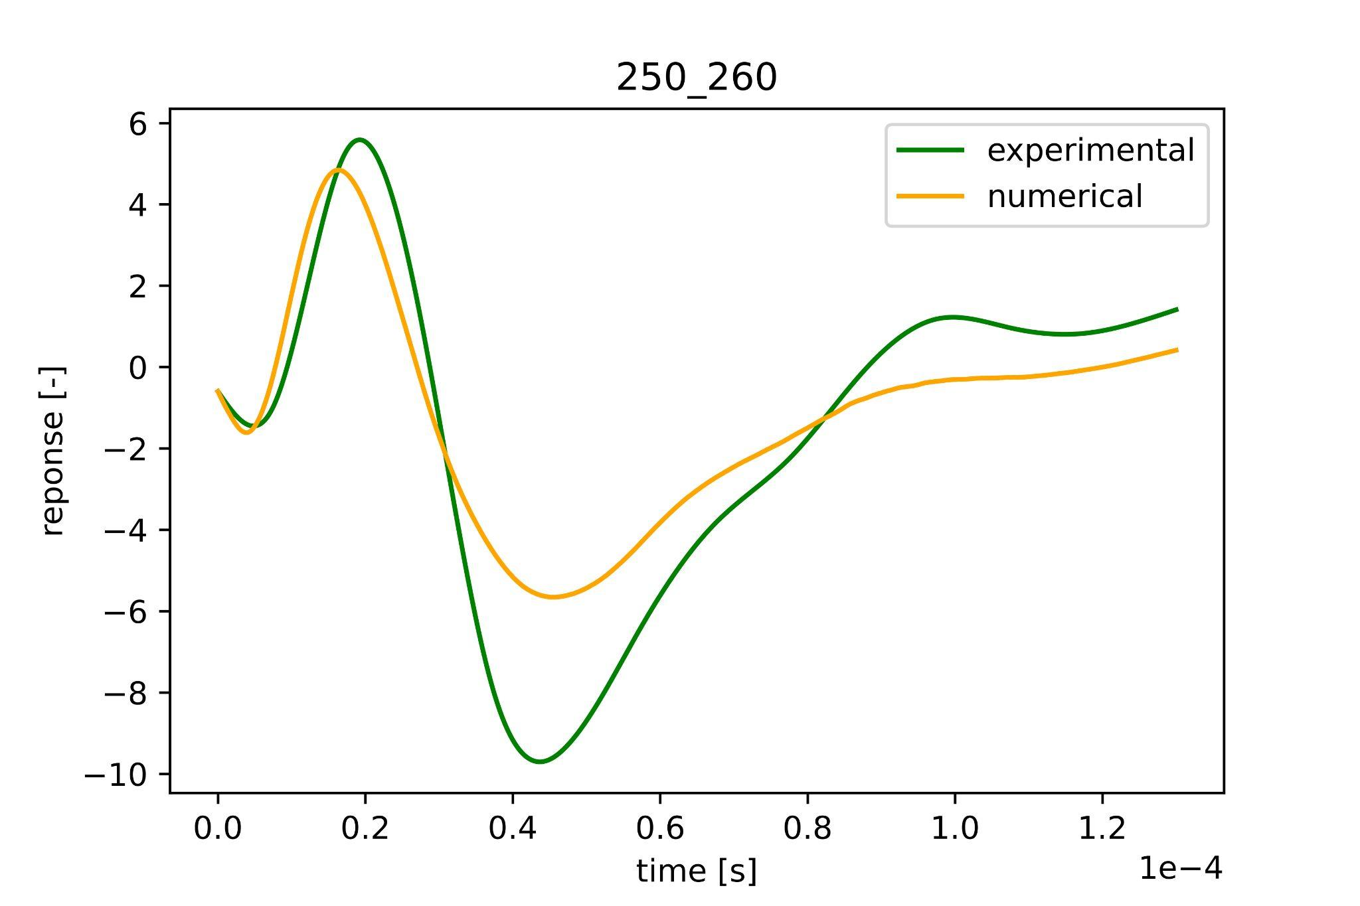
Data Preprocessing - Summary
Read data
Cut exp. data
Resample exp. data
Augmentation of num. data
Align num. and exp. data
Generate dataset
Numerical Data | [244, 100,4]
Augmented Data | [976,100,4]
Experimental Data | [24,100,4]
Prediction Data | [18,100,4]
Notes:
Here is an overview of our preprocessing steps.
We read the respective .matlab and .txt files into numpy arrays
while taking care of different decimal standards and different arrangement of sensors between numerical simulation and the experiment.
[circle mouse] Here you see the plotted response from four sensors.
Then we cut the experimental data to an appropriate length
by defining a range. e.g. (0.04995s to 0.05020s) in our case
After that we resample the experimental data to have the same timestep size as the numerical data i.e. 1e-8
For next steps, we augmented and aligned numerical data with the experimental data in the same timeframe.
Lastly, having tuned for optimal parameters for alignment, we export the final dataset as pickle files to be fed into the neural network.
[circle mouse] Here you see the shapes of our final datasets.

Slide 5
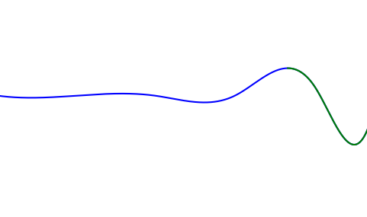
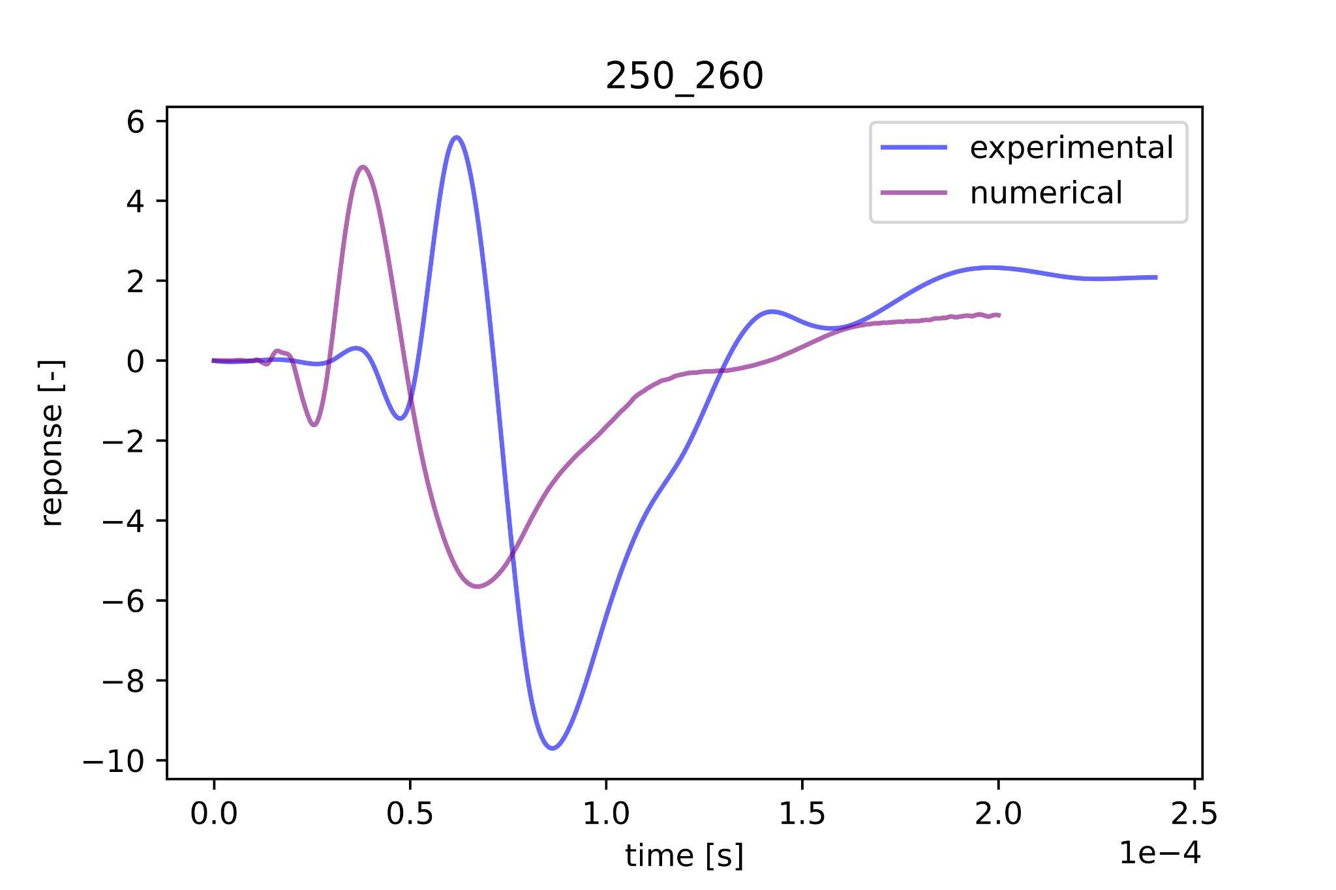
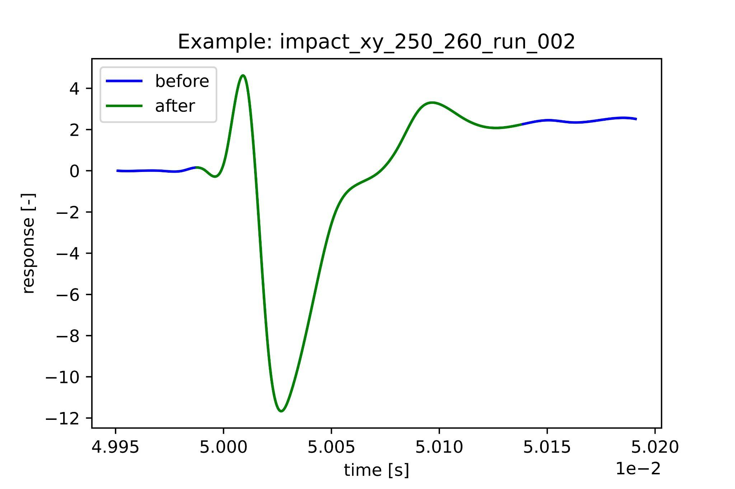
Data Preprocessing: Alignment of Numerical and Experimental Data
limit
Remove the first part of |y|<limit to obtain the main shape of the impact wave
Before alignment
After alignment
Notes:
To describe a bit more about our key preprocessing steps.
For alignment, we define a “limit” amplitude value which sets a starting point in time and take certain “length” of data points e.g. 13000 onwards.
[click]
On your right you can see how it improved the alignment.

Slide 6
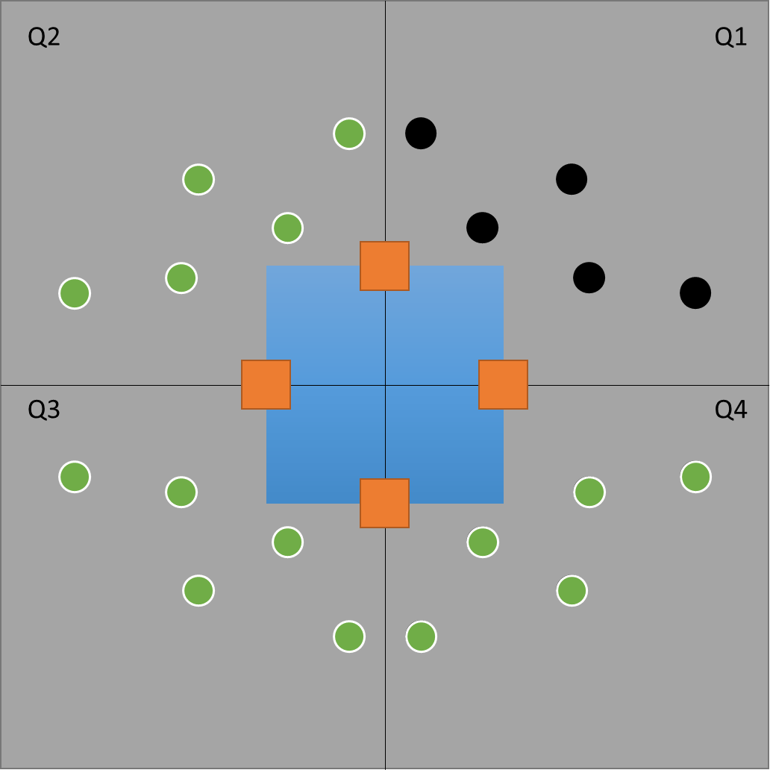
Data Preprocessing: Augmentation of Numerical Data
Generated data for collisions taking place in quadrants 2, 3 and 4 by rearranging the input sensor and channels
S1
Sensor signal arrangement for data augmentation
S2
S4
 | Ch.1 | Ch.2 | Ch.3 | Ch.4
Q1 | S1 | S2 | S3 | S4
Q2 | S1 | S4 | S3 | S2
Q3 | S3 | S4 | S1 | S2
Q4 | S3 | S2 | S1 | S4
S3
Notes:
For Data augmentation step, As we were given only numerical data for the first quadrant,
we augmented the numerical data by generating data for collisions taking place in quadrants 2, 3 and 4 and rearranging the input sensor and input channels.
Now that we have preprocessed the data, we can move onto the neural network part of the project.
[end before 1:30]

Slide 7
Neural Network - Summary
Load preprocessed data “.pickle”
Split numerical data into training, validation, test set (8:1:1)
Normalize input and/or target
Determine and implement calculation of error metrics
Implement baseline NN architecture (FCN/CNN/RNN(LSTM/GRU))
Tune the architecture
Tune hyperparameters
Repeat above steps with augmented numerical data
Notes:
For this section,
we ran our Neural network first with the given numerical data and later with our augmented numerical data.
General steps are as follows:
[click]
We loaded the preprocessed data as pickle files,
[click]
We Splitted the numerical data into training, validation, and test
[click][click][click]
Then we started with simple FCN/CNN/RNN as our baseline and determined Mean Squared Error as our error metric/ loss function,
Afterwards, we empirically tuned the architecture and hyper parameters to achieve good prediction without overfitting or underfitting.
[click]
In the following slides, we’d like to present our final choice of architecture and parameters for FCN/CNN/RNN.
(could skip)
Some of our key configuration decisions includes:
· Normalization of input and/or target,
· Layer type and depth,
· Choice of activation, loss function, and regularizer
· Number of epoch

Slide 8
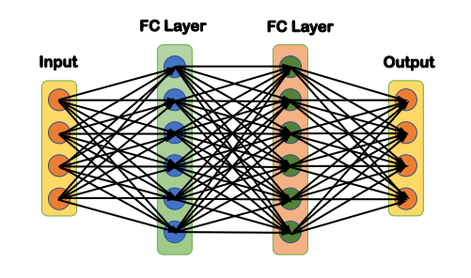
Neural Network: FCN Architecture
Tab1. FCN architecture and parameters
Layers | Parameters
Input | Input shape = (100,4)
FC layer | 128 units, ReLU activation, L2 regularizer
FC layer | 64 units, ReLU activation, L2 regularizer
Output | 2 units, tanh activation, MSE loss
Notes:
For Fully Connected Neural Network,
we settled on two hidden layers,
[click]
with reLU activation function and
L2 regularizer to reduce overfitting.
On our output layer,
[click]
we settled on MSE loss function and
hyperbolic tangent activation function as it corresponds with the minmax scalarization applied for target data.

Slide 9
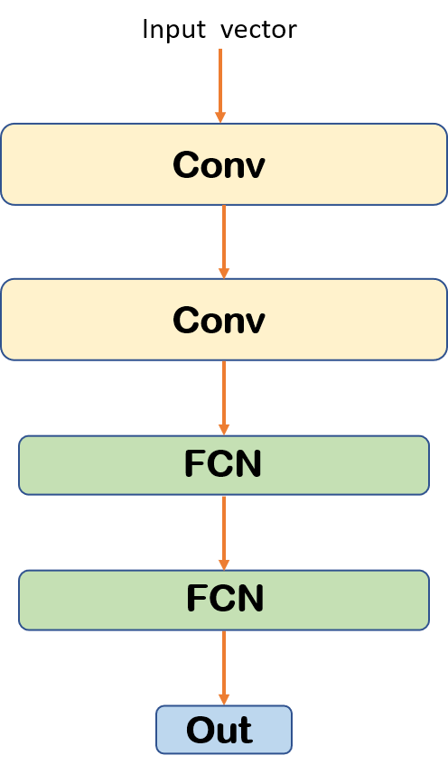
Neural Network: CNN Architecture
Tab2. CNN architecture and parameters
Layers | Parameters
Input | Input shape = (100,4)
Conv layer | Conv kernel = (50,2), depth = 8, ReLU activation
Max Pooling | Pooling kernel = (3,1)
Conv layer | Conv kernel = (10,2), depth = 8, ReLU activation
FC layer | Units = 32, ReLU activation, L2 regularizer
FC layer | Units = 8, ReLU activation, L2 regularizer
Output | Units = 2, tanh activation, MSE loss
Notes:
For Convolutional Neural Network,
[click] We settled on two convolutional layers with max pooling applied after each convolutional layer and two FC layers for our hidden layers.
Choice of activation function and loss remains same for each hidden and output layer as before.

Slide 10
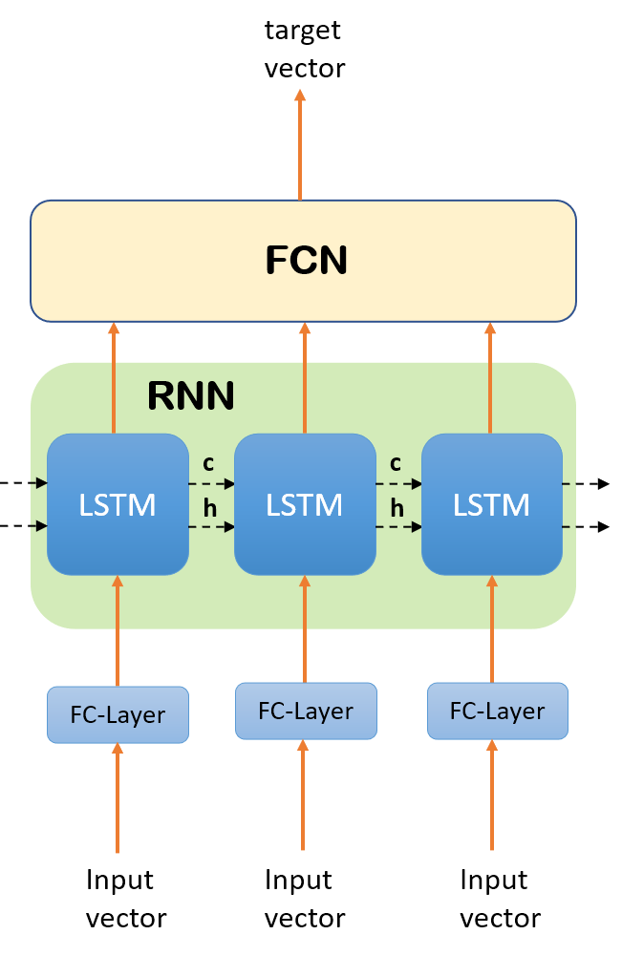
Neural Network: RNN Architecture
Tab3. RNN architecture and parameters
Layers | Parameters
Input | Input shape = (20,4)
FC layer | 8 units, ReLU activation, L2 regularizer
LSTM (GRU) | 64 units, ReLU activation
FC layer | 32 units, ReLU activation, L2 regularizer
FC layer | 16 units, ReLU activation, L2 regularizer
Output | 2 units, tanh activation, MSLE loss
Notes:
For Recurrent Neural Network,
we implemented LSTM and GRU, but the general structure remains similar.
As you can see on the left,
There are series of LSTM or GRU units corresponding to the time series.
and there are hidden states and cell states which can extract the information with time dependence.
The Outputs of each LSTM or GRU unit are gathered and fed into the FCN to get the prediction.
[click]
Note that the input shape is smaller as we sampled every five point from the original input.
[click]
Also, we take MSLE loss function for output layer.

Slide 11
First Run: Train, Validate and Test on Numerical Data (without augmentation)
Implementation details
Data normalization
Training set used for training Validation set used for parameters tuning Test set used for performance test on numerical data.
MSE loss functions for CNN and FCN MSLE loss functions for RNN MAE loss functions for model evaluation
Adam optimizer used as default choice
Data shuffling used for errors reduction
Tab4. MAE for different models on training, validation and test set
Model | Training | Validation | Test
FCN | 3.12 | 16.09 | 23.57
CNN | 1.52 | 9.75 | 19.16
RNN (LSTM) | 4.08 | 11.25 | 17.37
RNN (GRU) | 5.39 | 12.36 | 16.42
Notes:
Now we compare the results for our chosen models on training, validation and test set splitted from the non-augmented data.
For model evaluation, we used MAE loss functions as it gives a better intuitive and direct understanding of the result.
(E.g. how far away was the prediction to actual impact location.)
[click]]
Here we observe that GRU performs best on test
[click]
although training and validation error was smallest for CNN.

Slide 12
Second Run: Train on Augmented Num. Data and Test on Experimental data
Tab5. MAE for different models on experimental data
Model | MAE
FCN | 9.67
CNN | 17.85
RNN (LSTM) | 4.78
RNN (GRU) | 4.48
Data Augmentation
use the whole numerical dataset after augmentation as training set
greatly improved the results on experimental dataset
Notes:
For our final run, we used the whole augmented numerical dataset to train our tuned models and tested on the experimental data.
Here is the comparison chart of the Mean Absolute Error for different models on experimental data.
We see that training with augmented data greatly improved the results on experimental dataset.
[click]
Having run for many times, we consistently saw best prediction achieved by the GRU model.

Slide 13
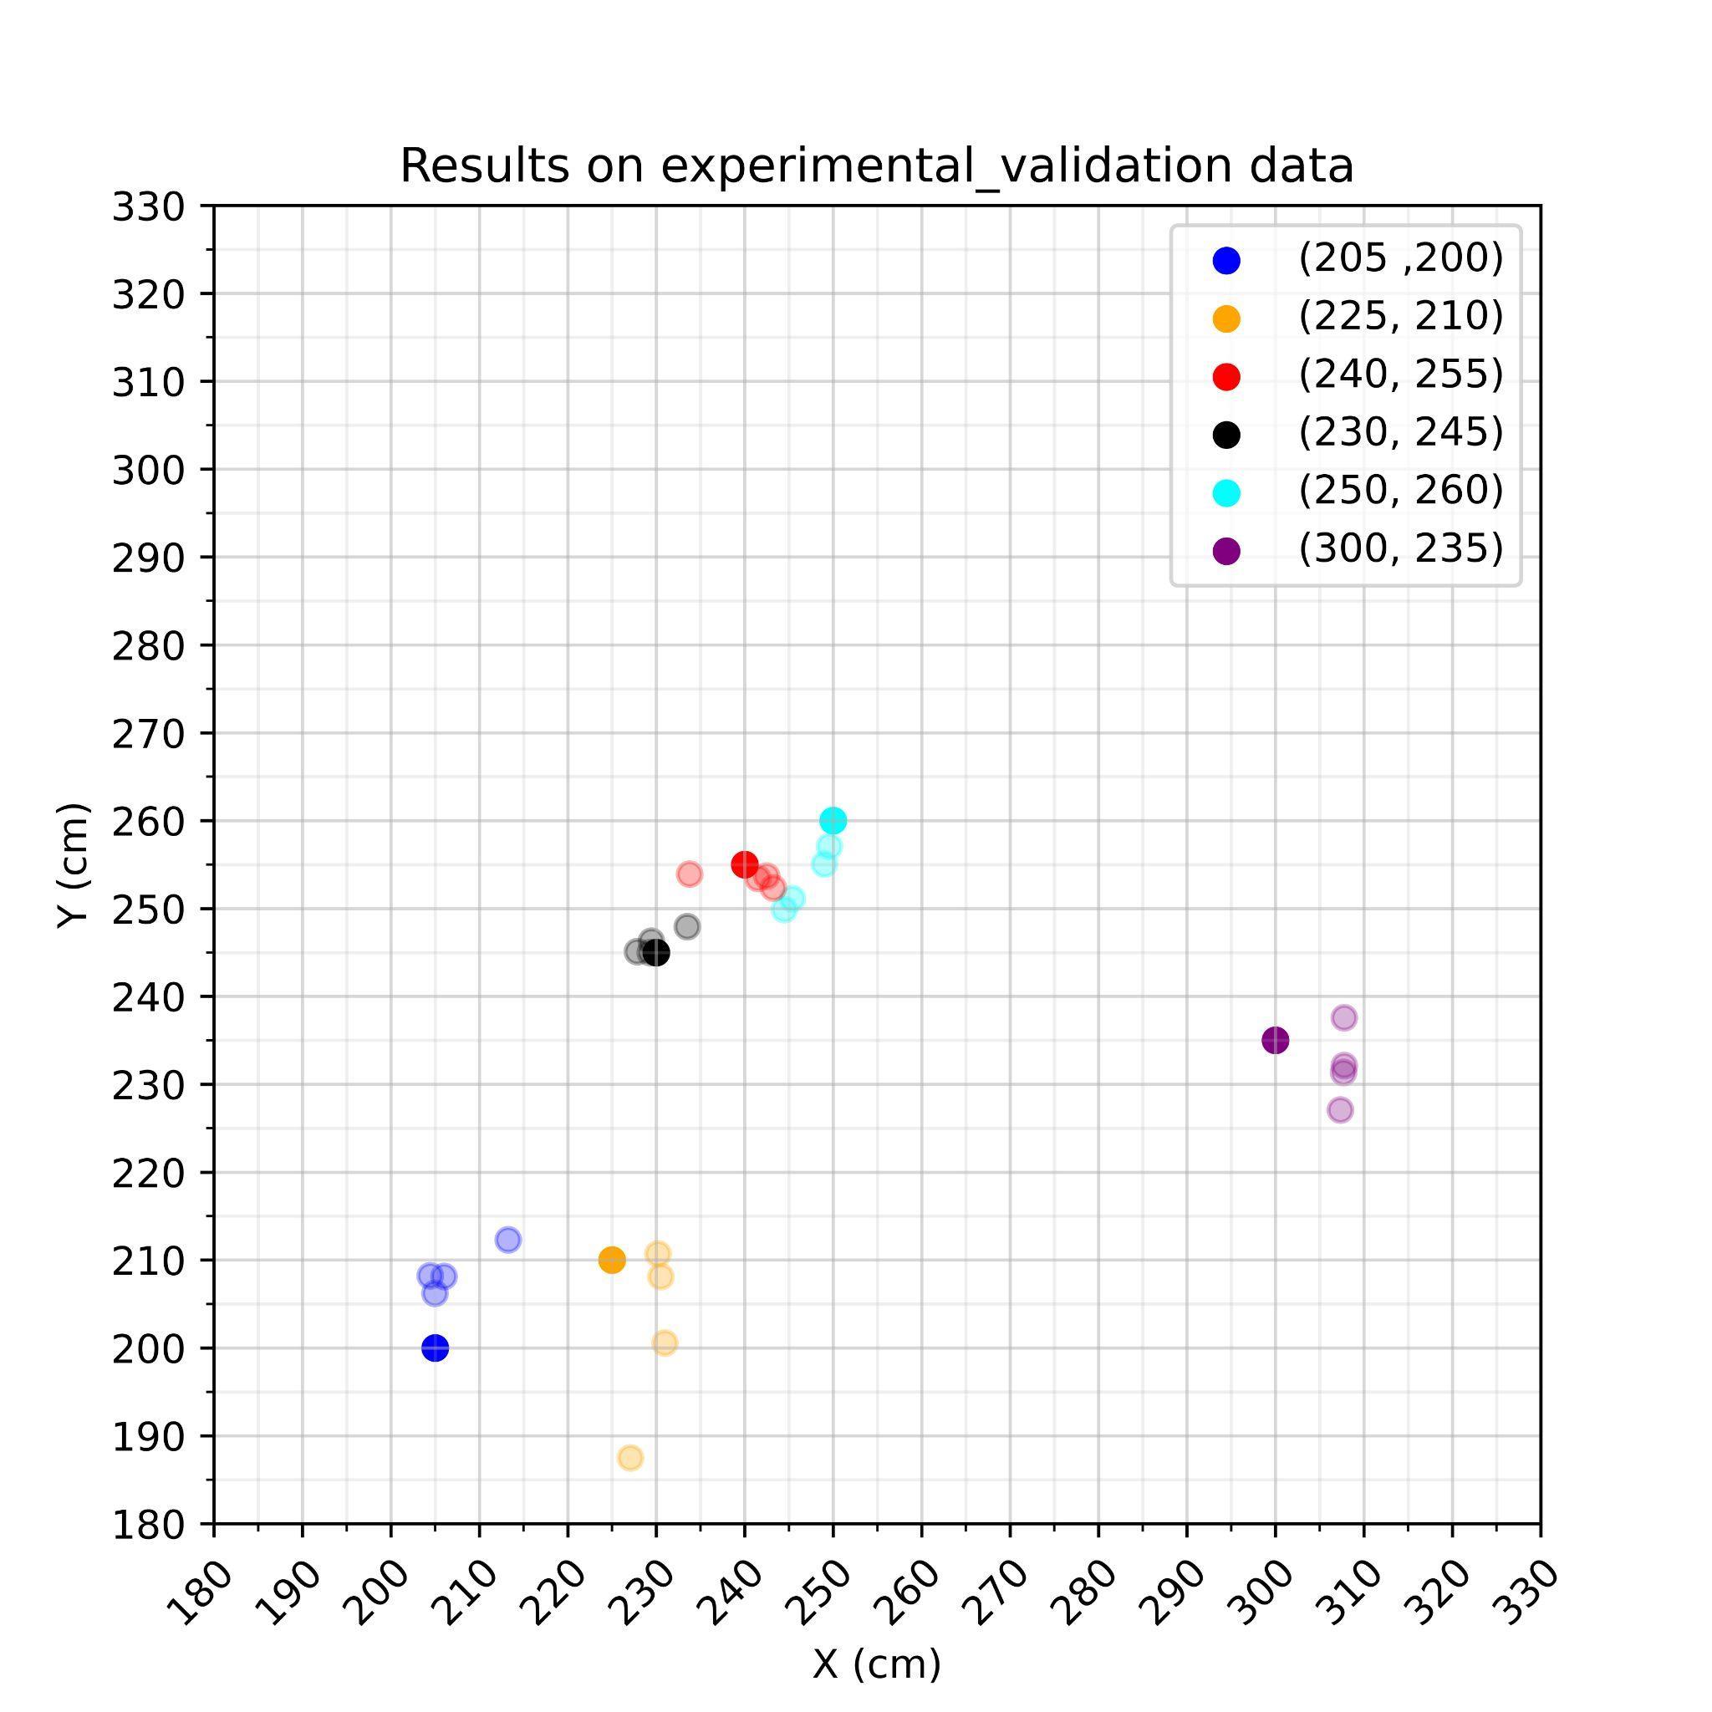
Visualization of GRU predictions on experimental_validation data
Observation
Center is (250, 250)
Impacts closer to the sensors are predicted better than those far away.
Notes:
To give a more intuitive understanding, we prepared a scatter plot with our best model predictions on experimental validation data.
Solid colors are the actual labels,
Lighter colors are the predictions at various iterations.
we see that impacts closer to the sensors i.e. those that lie close to the center are predicted better than those far away.

Slide 14
Final Prediction
[[245.59564 250.28908]
[261.75955 220.44699]
[233.2645 234.77596]
[230.66547 248.74158]
[249.03458 256.65952]
[247.60269 246.97462]
[186.9534 224.94916]
[224.73698 212.21803]
[255.09892 298.44788]
[247.69572 244.09216]
[255.3009 228.51135]
[230.11415 308.94138]
[261.03564 245.68115]
[230.63318 231.75743]
[247.78885 254.24402]
[259.27243 309.27954]
[243.00551 253.67584]
[283.48468 284.2997 ]]
Final Prediction
to the Experimental Data given to Group 5
Notes:
Here you have the final prediction coordinates to the experimental data given to our group.

Slide 15
Conclusion
Data Preprocessing
Setting limit value of 0.2 yields best performance (grid search)
Augmented data greatly improves prediction on experimental validation data
Neural Network
Best prediction was achieved by the GRU model
Impacts closer to the sensors are predicted better than those far away
Notes:
To summarize,
for data preprocessing,
[click]
We performed a grid search on the parameter and found limit value of 0.2 to yield best overall performance.
[click]
and we saw that prediction on experimental validation data is greatly improved using augmented data.
For Neural Network,
[click]
For most of the time, the best prediction was achieved by the GRU model
[click]
and we observed that Impacts that lie close to the center were predicted better than those distant from the sensors.
[end around 5:30]

Slide 16
Discussion and Possible Extensions
Data Preprocessing
Filtering was not necessary for this project
Align both numerical and experimental data along time and frequency
Analysis of the data obtained from repeated experiments may be used to further augment the training data by incorporating the uncertainty observed in the experimental data to the numerical data
Neural Network
RNN can extract information along time series, which is suitable for this task
GRU compared to LSTM, has a simpler structure and fewer parameters to reduce overfitting and get better results on validation set
Implement different combination of architectures e.g. CNN+LSTM
Notes:
For the scope of this project
[click]
we concluded that filtering was not necessary as the given data set quality was good enough after cutting.
[click]
Also we saw that aligning the signals along the time axes was sufficient to get good overall prediction. However, it would be also interesting to confirm these assumptions.
[click]
In addition, we think further analysis of data obtained from repeated experiments could provide for quality augmented data.
As for Neural Network,
[click]
we saw it befitting to focus on RNN as it can extract information along time series.
[click] And confirmed within our local experiments that GRU in fact gives better result than LSTM, which conventionally is more suitable for more complex problems.
[click] However, in the future, it would be interesting to see how combinations of different architectures perform.

Slide 17
Questions?

Slide 18
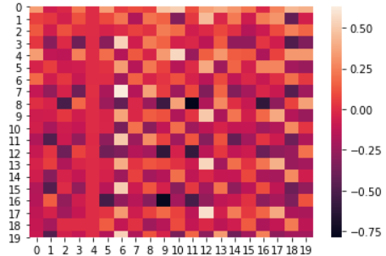
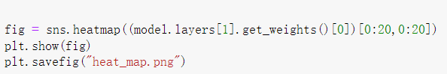
Neural Network: Automatic feature engineering
The first few layers would be responsible for the feature extraction
The white and black spots show the positions where the network thought as useful features
Heatmap of a part of the 1st layer’s weights

Slide 19
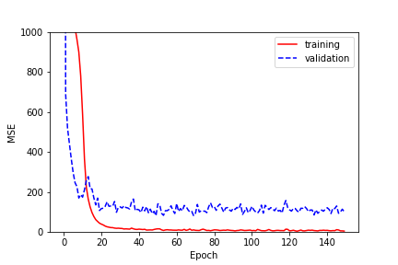
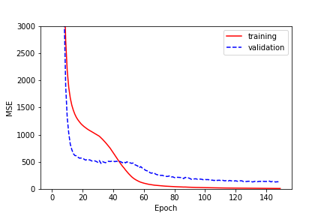
Neural Network: Losses of Training and Validation for Different Batch Sizes
Training loss and validation loss all in mean squared error for batch size = 5
Training loss and validation loss all in mean squared error for batch size = 40
For small batch sizes, training and validation loss converge more quickly but in an unstable way
Notes:
We have plotted losses of training and validation for different batch sizes.
We observe that for small batch sizes, training and validation loss converge more quickly but in an unstable manner.

Slide 20
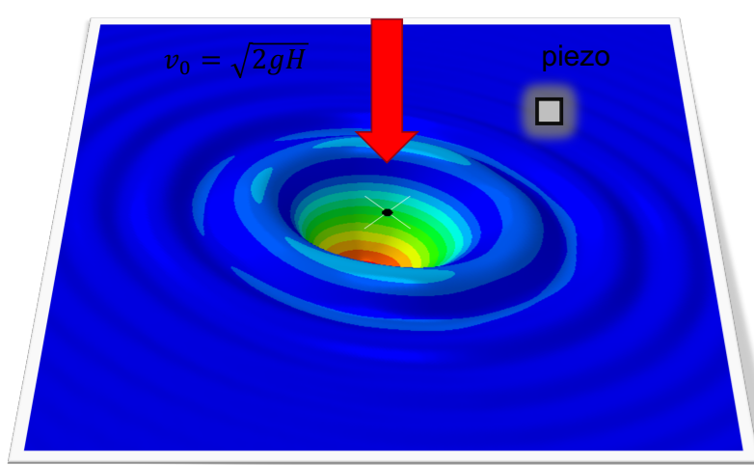
Discussion: Possible Experimental Extension
In addition to the falling position, we could also predict the height of the falling ball. Since the height determines the terminal velocity just before the ball reaches the plate, it would influence the time that the sensors react to the wave and possibly the wave’s shape etc.
The temperature, moisture and plate materials should also be able to be predicted since they would impact the wave propagation behaviour.
Notes:
Last but not least, a possible experimental extension is detailed on this slide.

